Slide 1
Global Superstore PROJECT

Slide 2


Global Superstore Project Stages:-
1- Data Understanding (Understand what each column represent). 2- Data Loading. 3- Data Exploration (Overview about the data). 4- Data Cleaning. 5- Feature Engineering. 6- Data Analysis. 7-Pipeline.

Slide 3
1- Data Understanding (Understand what each column represent). -Understand the structure of the dataset. -Import necessary analysis and processing libraries. 2- Data Loading. -Load the file Global_Superstore2.csv.

Slide 4

3-Data Exploration
Inspecting the structure of the dataset using: df.info() to display data types and the number of non-missing values. df.dtypes to identify the type of each column (numerical / categorical). -Understanding dataset size: df.shape to get the number of rows and columns. -Previewing sample data: df.head() to display the first 5 rows. -Listing column names: df.columns to retrieve all column names.

Slide 5
-Descriptive data analysis: df.describe(include='number') for descriptive statistics of numerical data. df.describe(include='object') for categorical data. -Analyzing column uniqueness: df.nunique() to count the number of unique values in each column. -Checking for duplicates: df.duplicated().sum() to count the number of duplicate rows. -Checking for missing values: df.isnull().sum() to get the number of missing values in each column. df.isnull().mean() * 100 to calculate the percentage of missing values.

Slide 6
4-Data Cleaning.
-Drop Duplicate Rows. - Handle Missing Values. - In-depth Check for Numerical Columns.
-Handle Outliers.
- Clean String Columns.
- Standardize Column Names.
-Type Conversion (Dates) - In-depth Check for Categorical Columns. - Reset the index after cleaning.

Slide 7
Summary of Actions Taken During the Cleaning:- Removing Duplicates: - Removed duplicate rows from the dataset using df.drop_duplicates(). Handling Missing Values: - Calculated the percentage of missing values for each column. - Deleted rows with missing values in columns with less than 5% missing data. - Deleted columns with more than 40% missing values.

Slide 8
In-depth Check for Numerical Columns: - Identified numerical columns using df.select_dtypes(). - Plotted histograms for each numerical column using Plotly. - Displayed summary statistics using .describe(). - Counted unique values in numerical columns. - Checked for negative values in numerical columns. - Visualized distributions using boxplots (top 6 numerical columns) with Seaborn and Matplotlib.

Slide 9
Handling Outliers:
Detect and reduce numeric outliers using the IQR (Interquartile Range) method.
Steps:
-Select numeric columns: num_cols = df_raw.select_dtypes(include='number’)
-Calculate bounds:
Q1 = 25th percentile
Q3 = 75th percentile
IQR = Q3 − Q1-
Limits → lb = Q1 − 1.5*IQR, ub = Q3 + 1.5*IQR
-Count outliers: Values outside [lb, ub] are outliers.
-Cap values (Winsorize): Replace values below/above bounds using clip(lower=lb, upper=ub).
-Compare before vs after: Show number of outliers reduced per column.

Slide 10
String Cleanup -Removed extra spaces and converted values to lowercase in columns like: 'Order ID', 'Order Date', 'Ship Date', 'Ship Mode', 'Customer ID', 'Customer Name, etc.
Standardize Column Names -Cleaned column names:-Replaced spaces with underscores _&Removed brackets ().
Type Conversion (Dates) -Convert text date columns into proper datetime format for analysis -Define date columns → ["Order Date", "Ship Date"]
-Loop through each column in the list
-If the column exists → convert using -pd.to_datetime(df[c], format="%d-%m-%Y", errors="coerce")
-Invalid values become NaT (missing date)

Slide 11
In-depth Check for Categorical Columns: - Displayed top 3 most frequent categories for each categorical column. - Counted unique values and listed them for each column. - Calculated dominant category ratio (max frequency percentage) per column. Redefine Numerical Columns after Cleaning: -Re-selected numerical columns after cleaning. - Replotted final histograms to validate data after removing outliers and irrelevant columns.

Slide 12
5-FEATURE ENGINEERING:-
-DOMAIN KNOWLEDGE FEATURES.
-DATE AND TIME FEATURES.
-KPIs & CORE AGGREGATIONS. -RFM SCORING.
-PROFITABILITY PIVOTS.
-ABC ANALYSIS (Products & Customers by Profit).
-COHORT RETENTION (Monthly).

Slide 13
Summary of Actions Taken During FEATURE ENGINEERING:- Domain Knowledge Features:-
-- Unit_Price: Sales ÷ Quantity → price per unit. -- Gross_Margin_Pct: Profit ÷ Sales → overall profit margin %. -- Profitability_Category: Simplified Profit_Bucket into Loss / Low / Medium / High. -- Discount_Pct: Cleaned discount values between 0 and 1. -- Discount_Level: Grouped discounts into 0%, 0–10%, 10–20%, 20–30%, 30%+. -- Is_Profitable: Flag for positive profit orders. -- Profit_Bucket: Binned profit into Loss, Low, Medium, High (based on percentiles). -- Ship_Delay_Days: Days between Order Date and Ship Date. -- UnitPrice_Band: Categorized unit price into Low, Mid, High, Premium.

Slide 14
Date & Time Features:-
-- Order_Year: Extracted year from Order Date. -- Order_Month: Extracted month number. -- Order_Quarter: Extracted fiscal quarter (1–4). -- Order_YearMonth: Combined year and month (e.g., “2023-07”). -- Order_Weekday: Extracted day name (e.g., Monday, Tuesday). -- Order_DOW: Day of week as number (0=Monday → 6=Sunday). -- Order_Weekend: Flag for weekend orders (Saturday/Sunday = 1).

Slide 15
KPIs & Core Aggregations:-
-- Total_Sales: Sum of all sales values. -- Total_Profit: Sum of all profit values. -- Overall_Margin_Pct: Ratio = Total_Profit ÷ Total_Sales. -- Orders_Count: Number of unique orders. -- Customers_Count: Number of unique customers. -- Products_Count: Number of unique products.
Aggregations & Trends
-- Monthly_Sales_Profit: Grouped by Order_YearMonth → shows monthly sales and profit trends. -- Category_Splits: Summarized Sales & Profit by: • Category • Sub-Category • Segment • Country

Slide 16
RFM Scoring (Recency–Frequency–Monetary):-
Goal: Classify customers based on purchasing behavior.
Metrics Calculated:-
-- Recency_Days: Days since the customer’s last order. -- Frequency: Number of unique orders per customer. -- Monetary: Total sales amount per customer.
Scoring & Segmentation:-
--R_Score: Recency ranked into 5 quantiles (1–5). -- F_Score: Frequency ranked into 5 quantiles (1–5). -- M_Score: Monetary value ranked into 5 quantiles (1–5). -- RFM_Segment: Combined code (e.g., “545”). -- RFM_Score: Sum of R, F, and M scores → overall customer value indicator.
✅ Helps identify loyal, high-value, and inactive customers for targeted strategies.

Slide 17
Profitability Pivots:-
Goal: Summarize profit performance across key business dimensions.
Created Pivot Tables:-
-- Profit_Country_by_Category: Profit totals by Country × Category.
-- Profit_Segment_by_Category: Profit totals by Customer Segment × Category.
-- Profit_Year_by_Category: Yearly profit comparison across categories.
-- Profit_Quarter_by_Category: Quarterly profit trends per category.
✅ Enables multi-dimensional profit analysis to identify top-performing regions, segments, and time periods.

Slide 18
ABC Analysis (Products & Customers by Profit):-
Goal: Classify products and customers based on their contribution to total profit.
Method:
-- Sort items by total Profit (descending). -- Compute each item’s cumulative share of overall profit. -- Assign ABC categories based on contribution: • A: Top 80% of profit (most valuable) • B: Next 15% of profit (moderate value) • C: Remaining 5% (low value)
Outputs:
--ABC_Products_by_Profit: Product-level profitability ranking. -- ABC_Customers_by_Profit: Customer-level profitability ranking.
✅ Supports strategic focus on high-profit products & key customers.

Slide 19
Cohort Retention (Monthly):-
Goal: Measure customer retention over time based on first purchase month.
Process:
-- Extract OrderMonth (month of each order). -- Identify each customer’s CohortMonth (first purchase month). -- Compute MonthIndex = months since first purchase. -- Build a cohort table showing unique customers per month since joining. -- Calculate Retention Rate = active customers ÷ initial cohort size.
Outputs:
-- Cohort Sizes: Number of new customers per first month. -- Retention Table: Monthly retention ratios for each cohort.
✅ Helps track customer loyalty and long-term engagement trends.

Slide 20

6-Data Analysis:-
Data Analysis
Univariate
Bivariate
Multivariate

Slide 21

6-Data Analysis:-
Analytical Questions:
Univariate Analysis (Single Variable)
1-Calculated: Overall column means. 2-Calculated: Overall column medians. 3-Calculated: standard deviation of each numerical column.

Slide 22
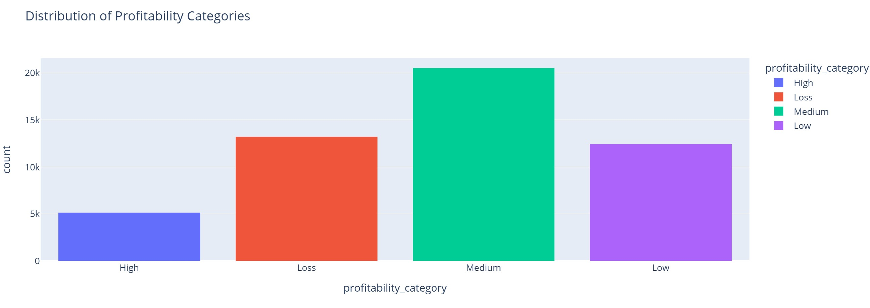
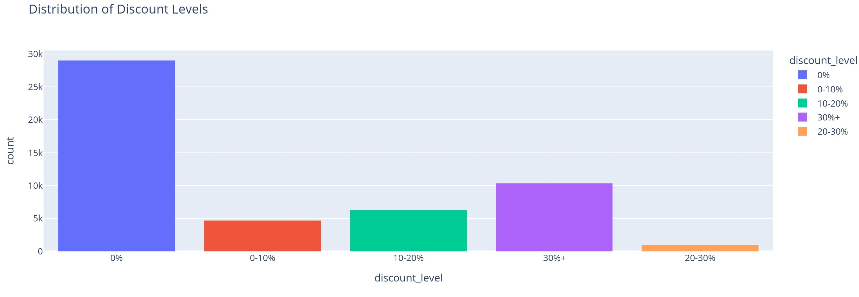
4-Distribution of Profitability Categories
A histogram was used to show the distribution of orders by Profitability Category.
5- Distribution of Discount Levels
A histogram was used to show how discount levels are distributed across orders.

Slide 23
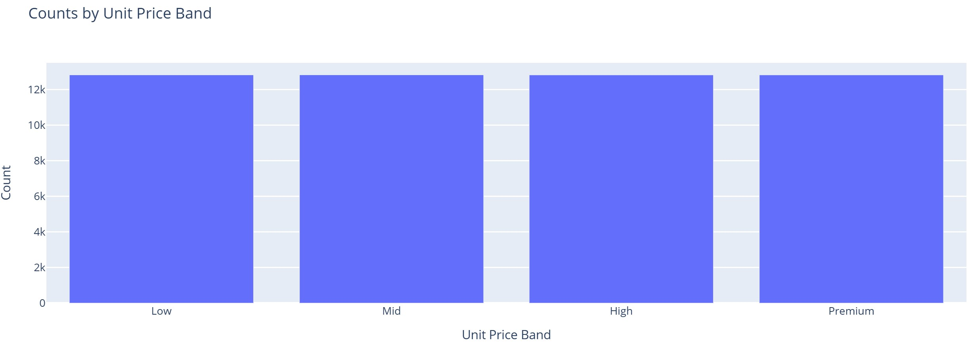
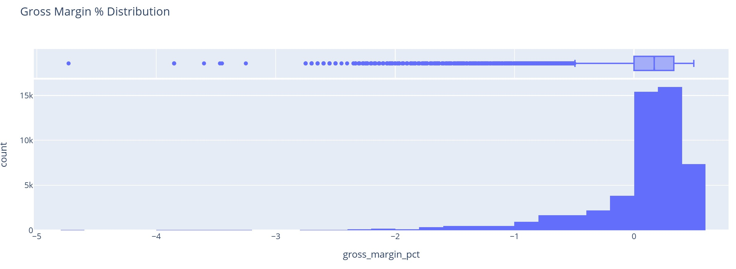
6-How many lines fall into each unit price band?
Builds a clean bar chart of Unit Price Band distribution by:
computing value counts of unitprice_band,
excluding null bands from the plot, and
visualizing counts per band with Plotly (clear title and axis labels).
7-Distribution of Gross Margin %?
A histogram with marginal box plot was used to analyze the distribution of profit margins.

Slide 24
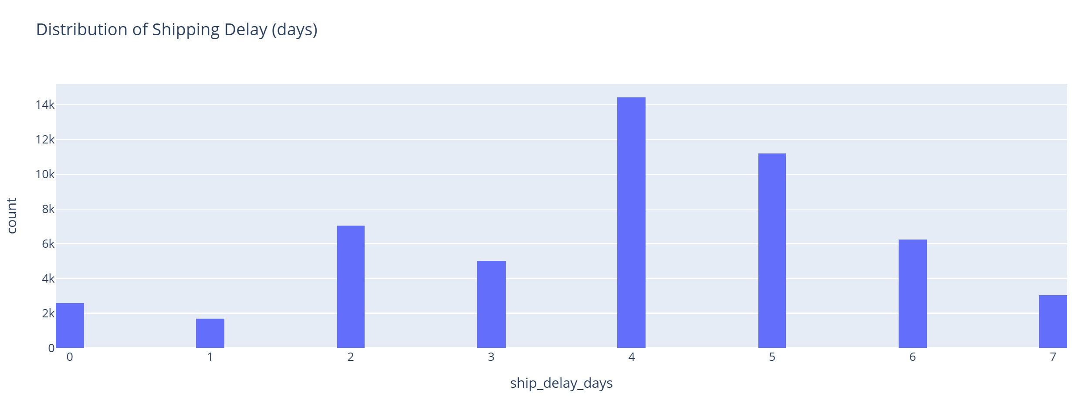
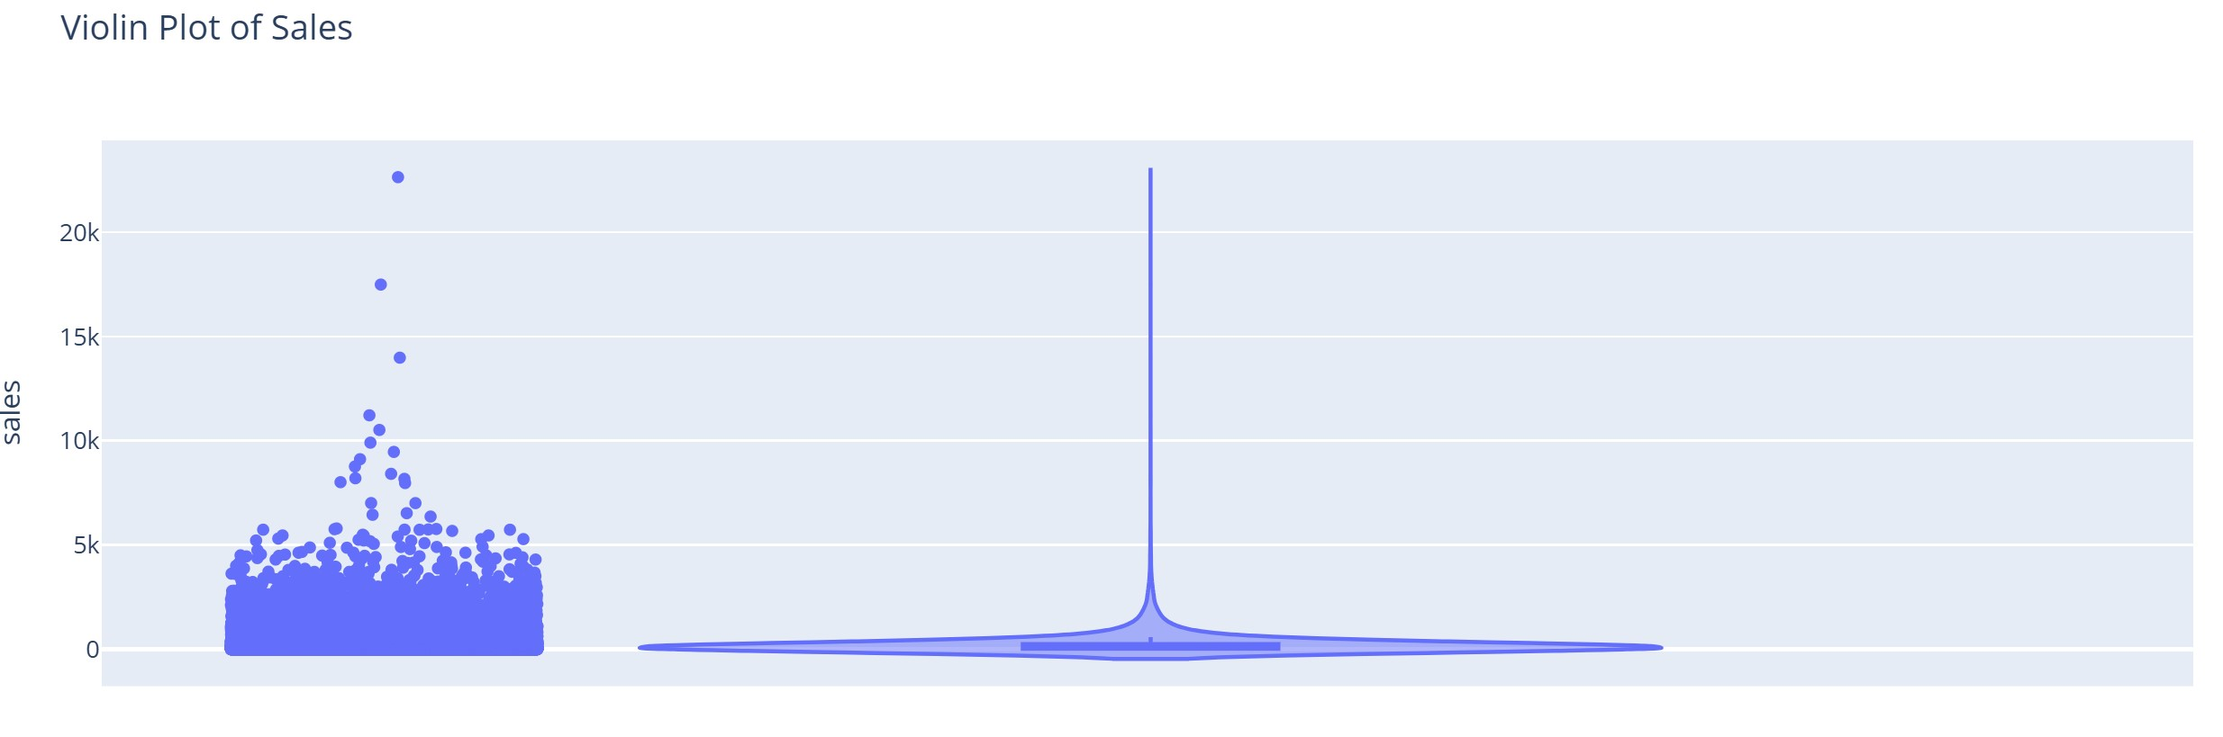
8-How are shipping delays distributed?
A histogram was used to show the distribution of shipping delays in days.
9-What is the density & distribution of Sales?
Violin Plot to assess central tendency, skewness, and tail behavior of Sales.

Slide 25
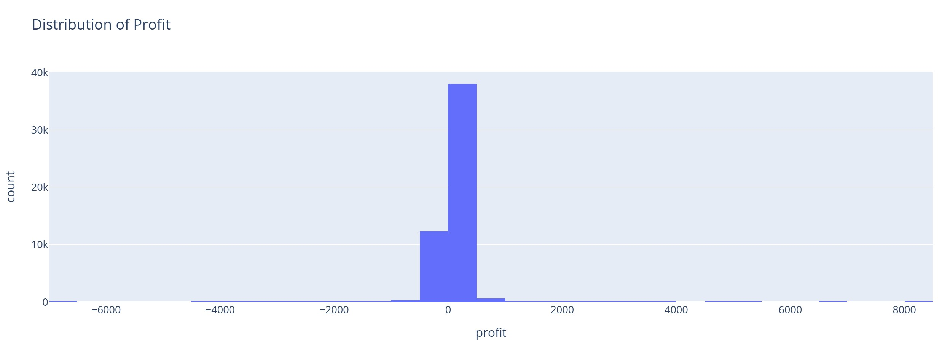
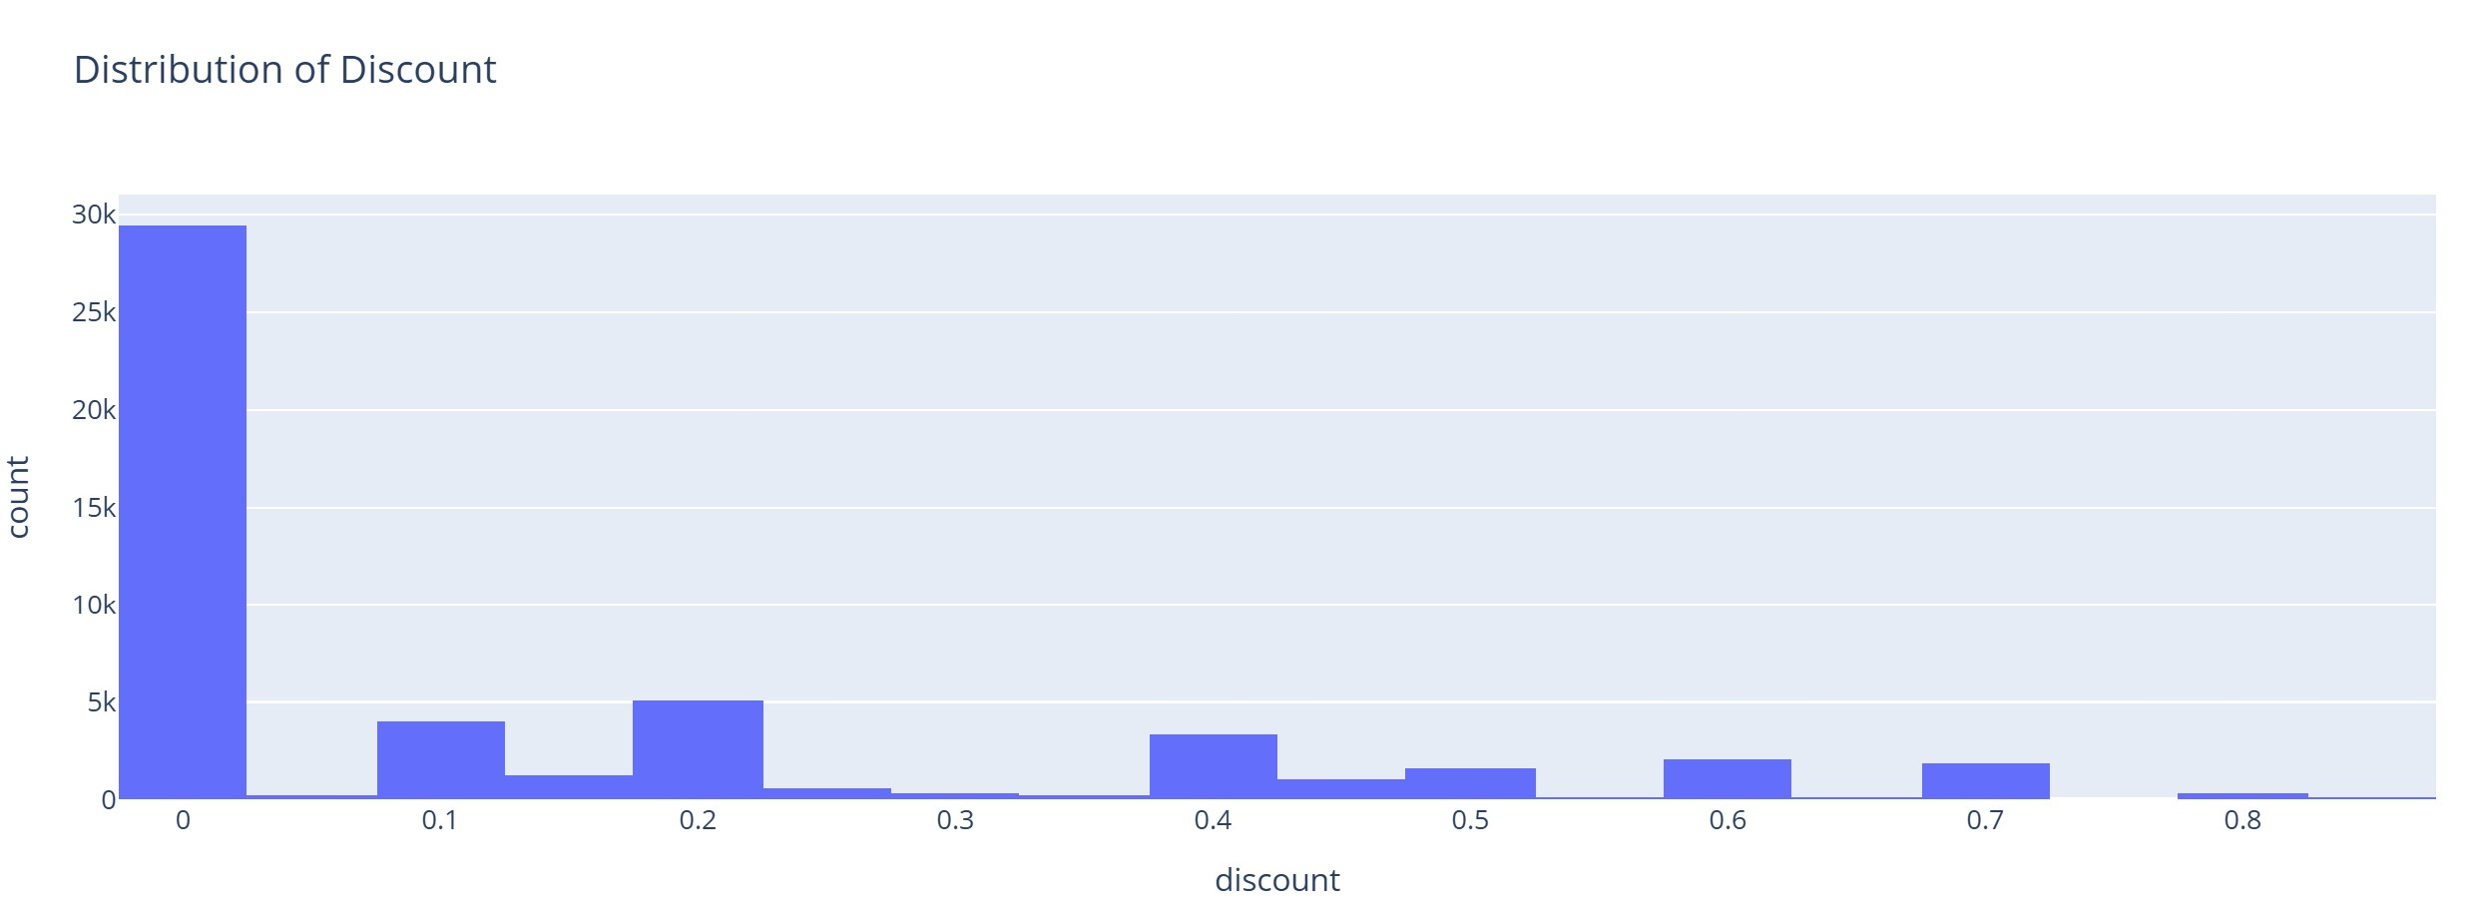
10-What is the distribution of Profit?
Histogram to check profitability spread, symmetry, and presence of negative-profit tail.
11-How is Discount distributed?
Histogram to examine common discount levels and detect unusual/rare discounting patterns.

Slide 26
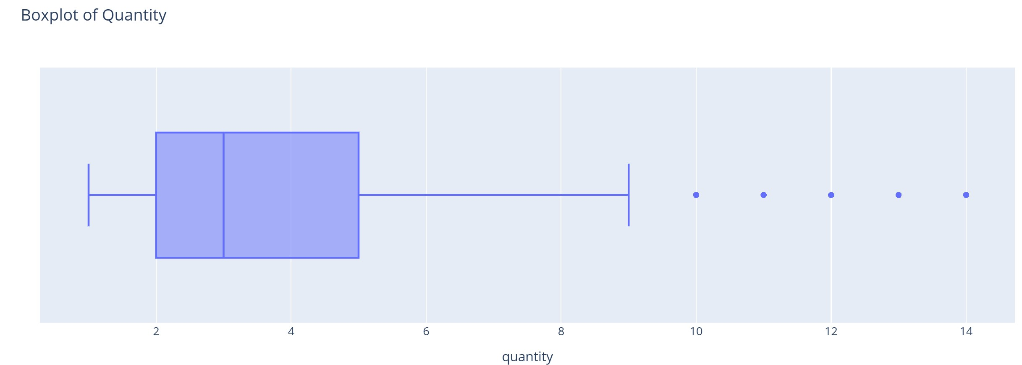
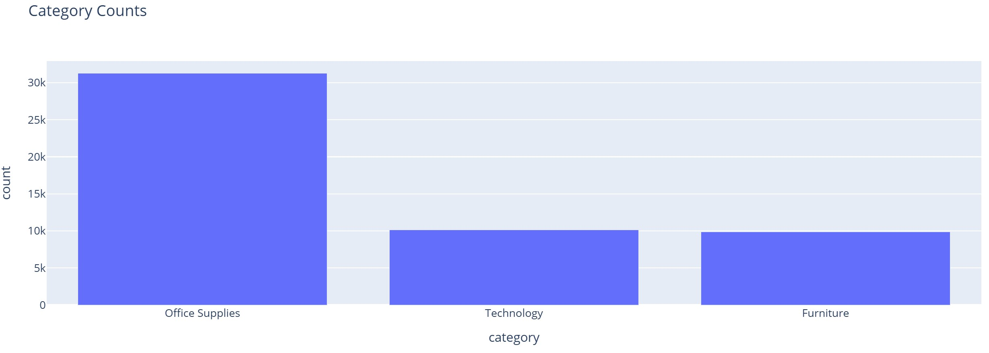
12- What is the distribution of Quantity?
Box plot to reveal median, IQR, and outliers in item quantities per order.
13-Which Categories have the most records?
Counts how many times each category appears in the dataset.
Converts the counts into a DataFrame for plotting.
Renames columns to “category” and “count”.
Creates a bar chart showing category frequencies using Plotly Express.

Slide 27
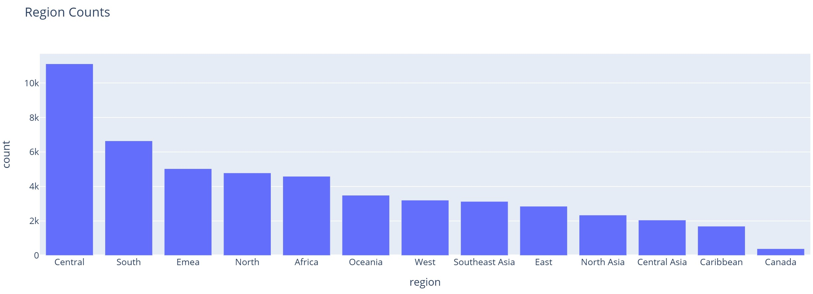
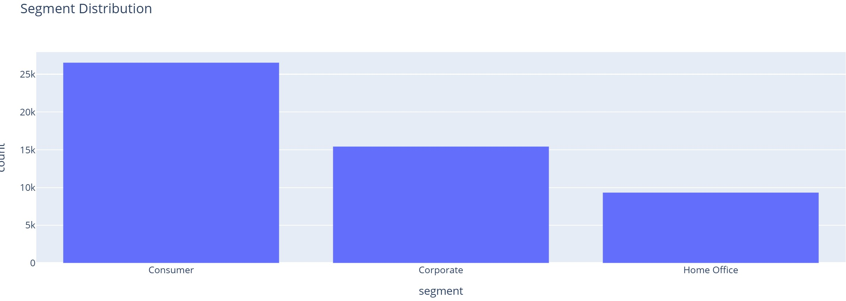
14-Which Regions contribute the most?
Counts how many times each region appears in the dataset.
Converts the result into a DataFrame for visualization.
Renames columns to “region” and “count”.
Creates a bar chart showing the number of records per region using Plotly Expres
15-How are Segments distributed?
Histogram of customer Segments to understand user mix (Consumer, Corporate, Home Office, etc.).

Slide 28
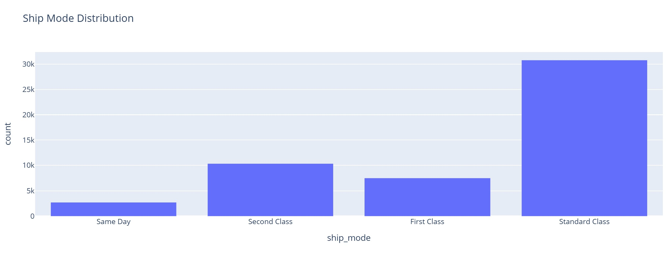
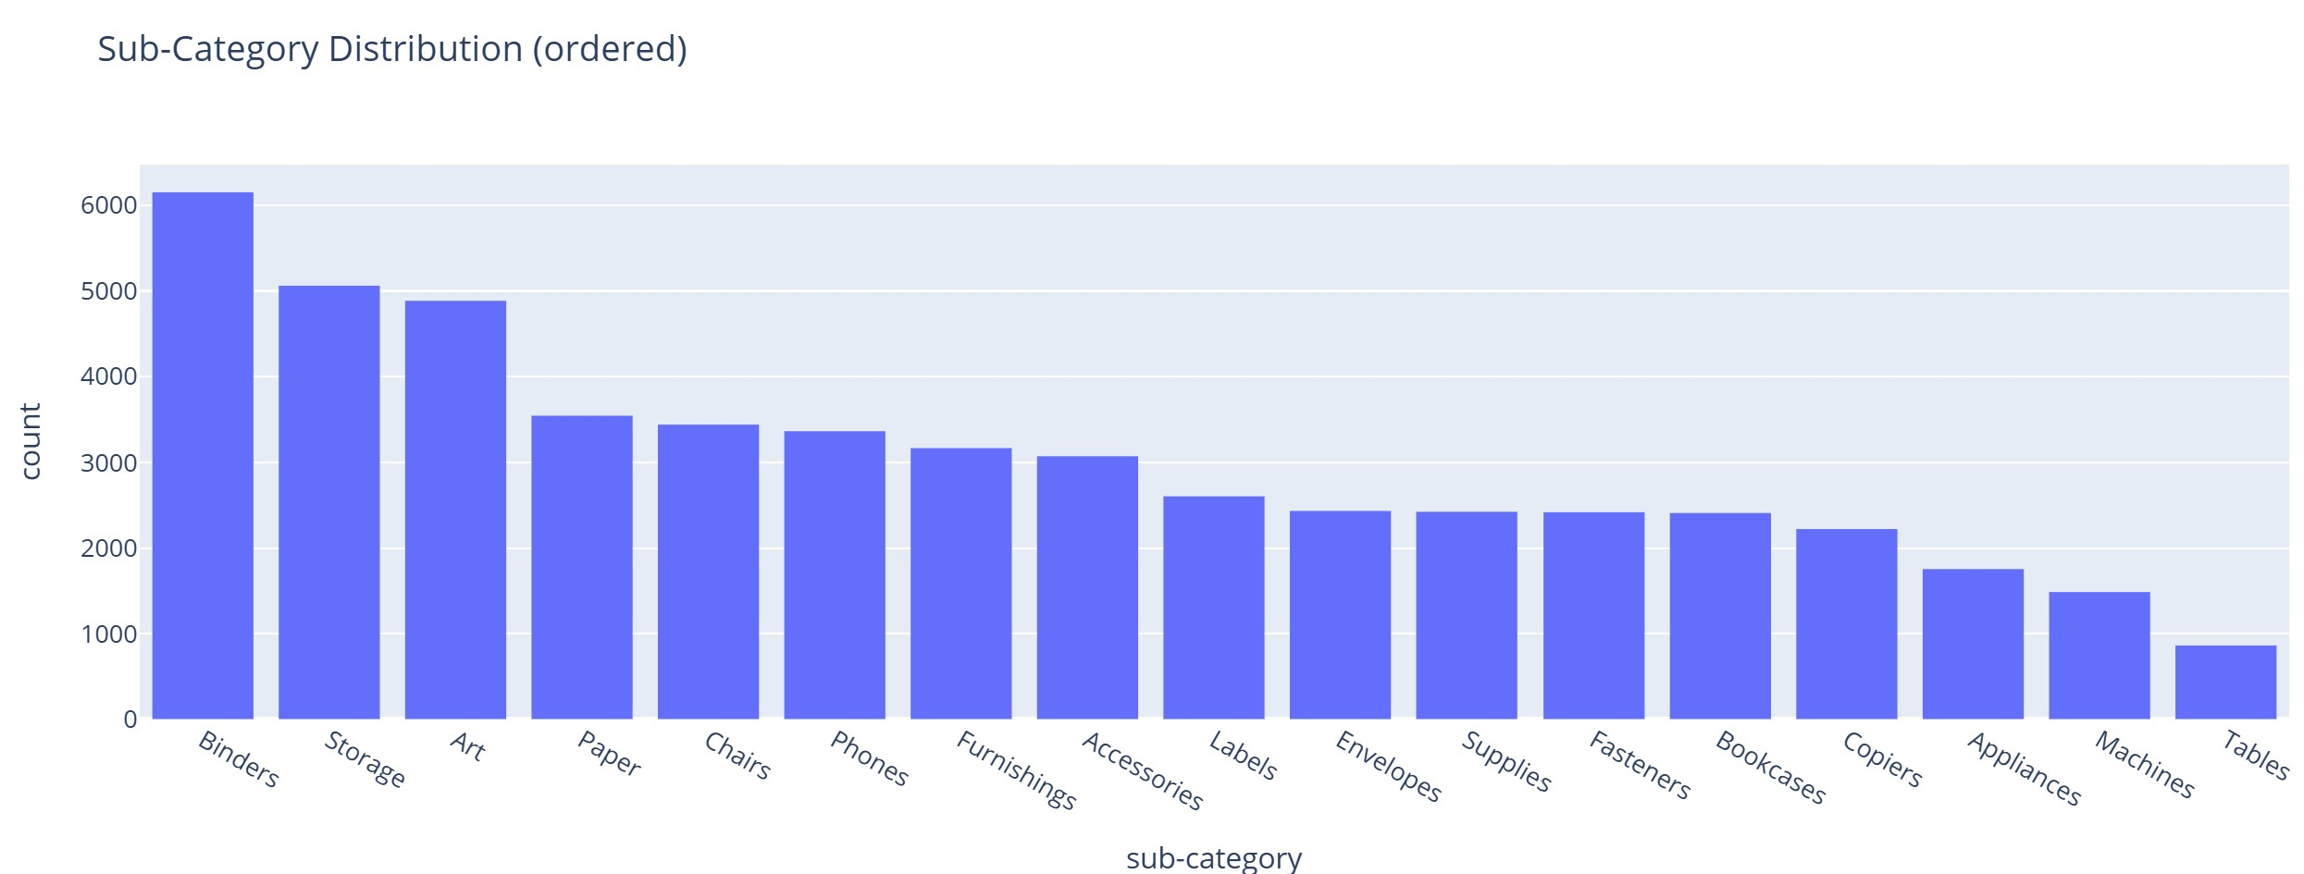
16-What is the frequency of different Ship Modes?
Histogram of Ship Mode to inspect operational mix (Standard, Second Class, First Class, Same Day).
17-What are the most common Sub-Categories?
Ordered bar chart ranks Sub-Categories by frequency to expose long-tail items.

Slide 29
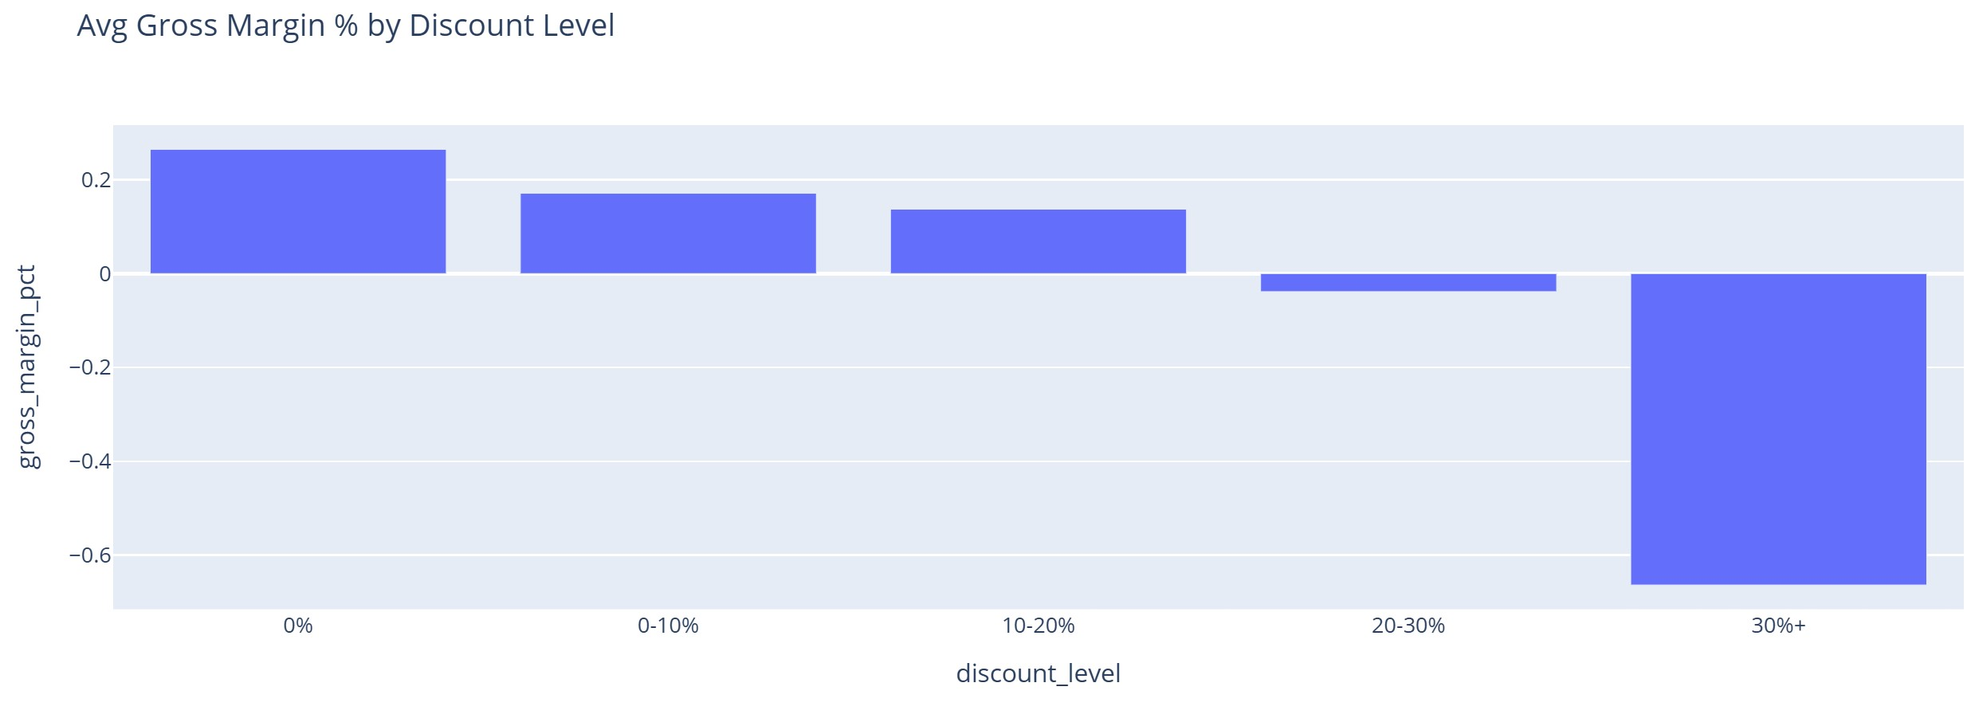
Bivariate Analysis (Two Variables)
1-calculate mean 'sales' for each 'category'?
Groups the data by category, including missing values (dropna=False).
Calculates the average (mean) sales for each category.
Prints the mean sales per category to the output.
2-How does the average gross margin vary across discount levels?
Groups the data by discount level.
Calculates the average gross margin percentage for each discount level.
Creates a bar chart showing the average gross margin % by discount level using Plotly Express.

Slide 30
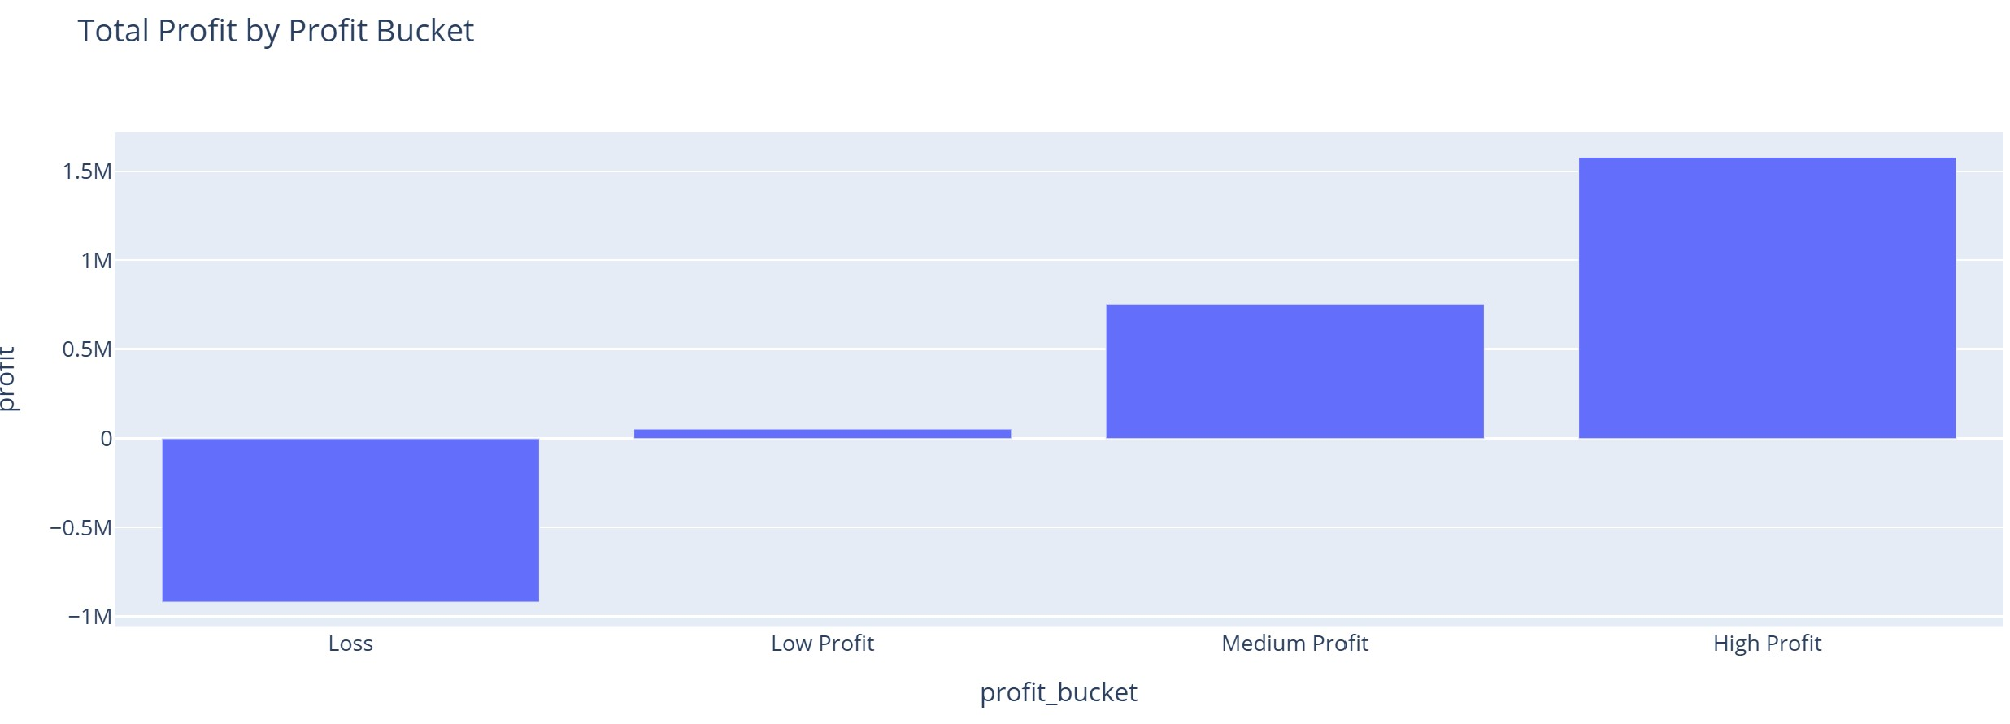
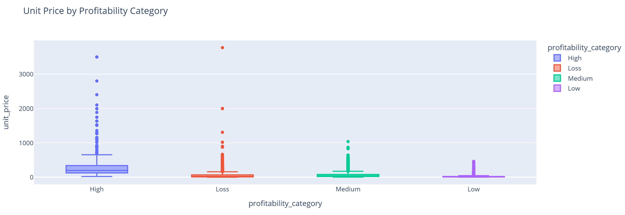
3-Which profit bucket contributes most to total profit?
A bar chart was used to show which profit buckets contribute most to total profit.
4-How does unit price differ across profitability categories?
A box plot was used to compare unit price distribution across profitability categories.

Slide 31
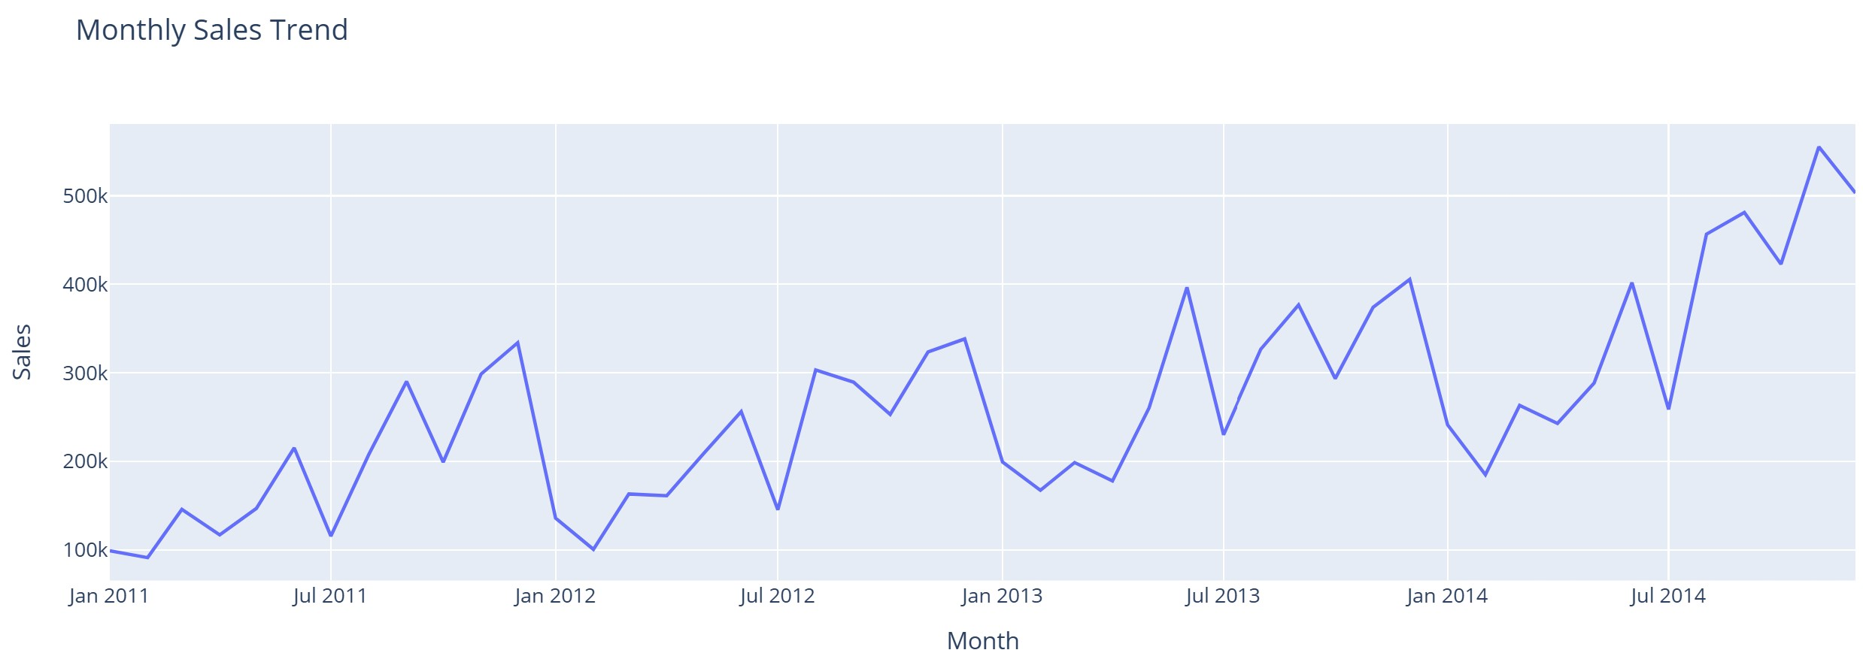
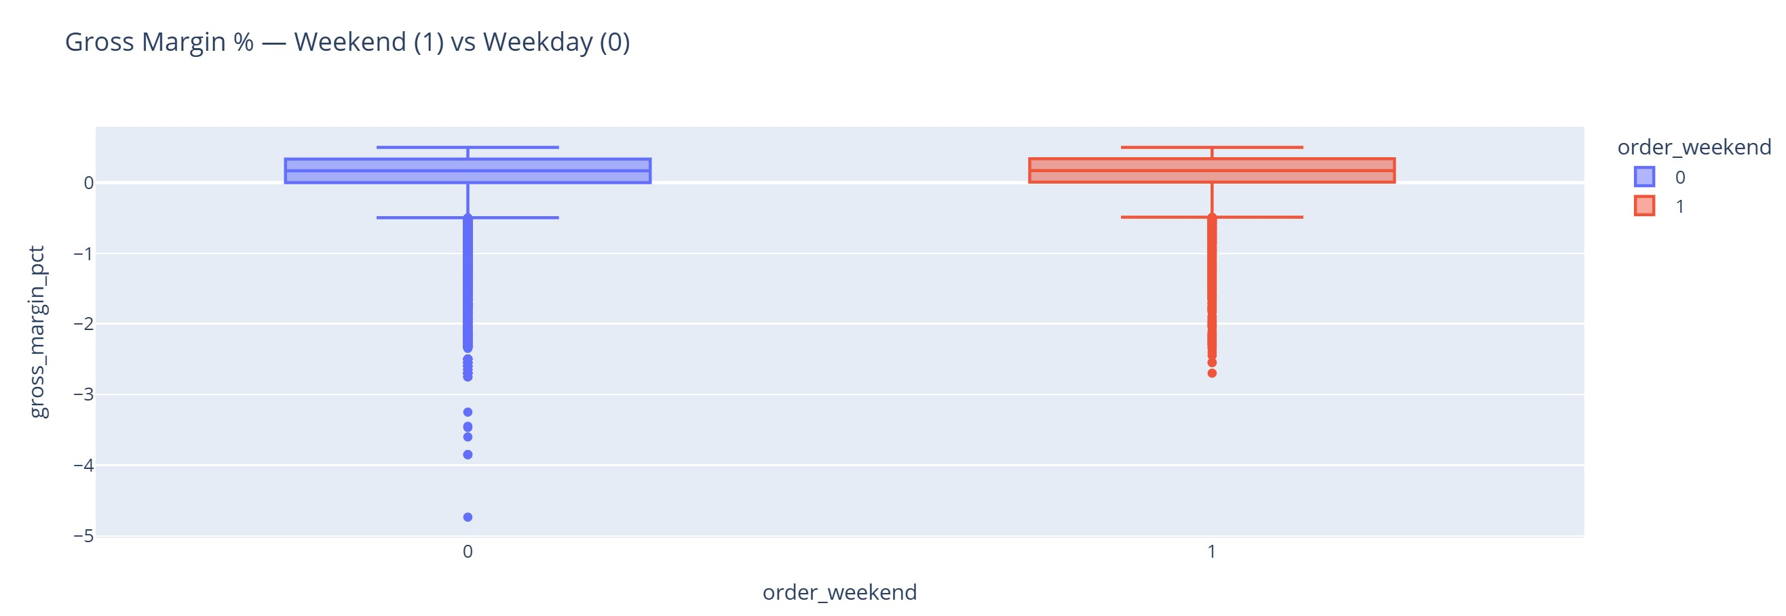
5-How do sales evolve over time (by month)?
A line chart was used to visualize how sales evolve month over month.
6-Is there a margin difference between weekend vs weekday orders?
A box plot was used to compare gross margin % between weekend and weekday orders.

Slide 32
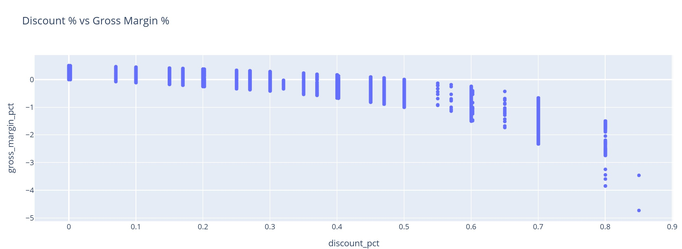
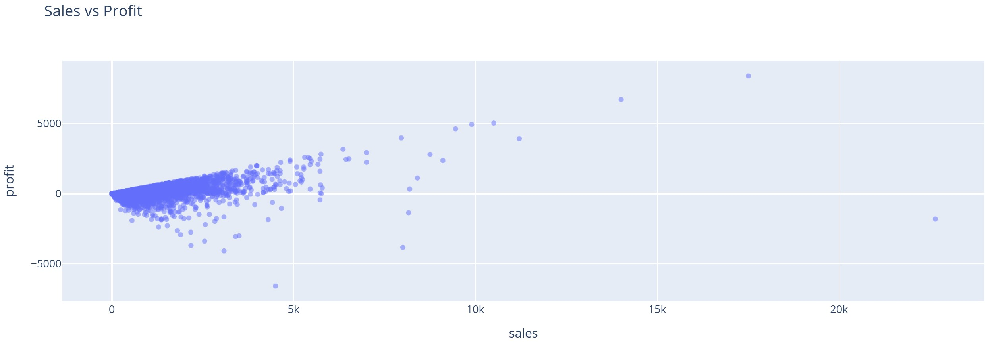
7-What is the relationship between discount rate and gross margin?
Removes rows with missing values in discount_pct or gross_margin_pct.
Creates a scatter plot comparing Discount % (x-axis) and Gross Margin % (y-axis).
Adds category, sub-category, and product_name as hover details.
8- What is the relationship between Sales and Profit?
Scatter plot reveals linearity/non-linearity, heteroscedasticity, and high-sales low-profit cases.

Slide 33
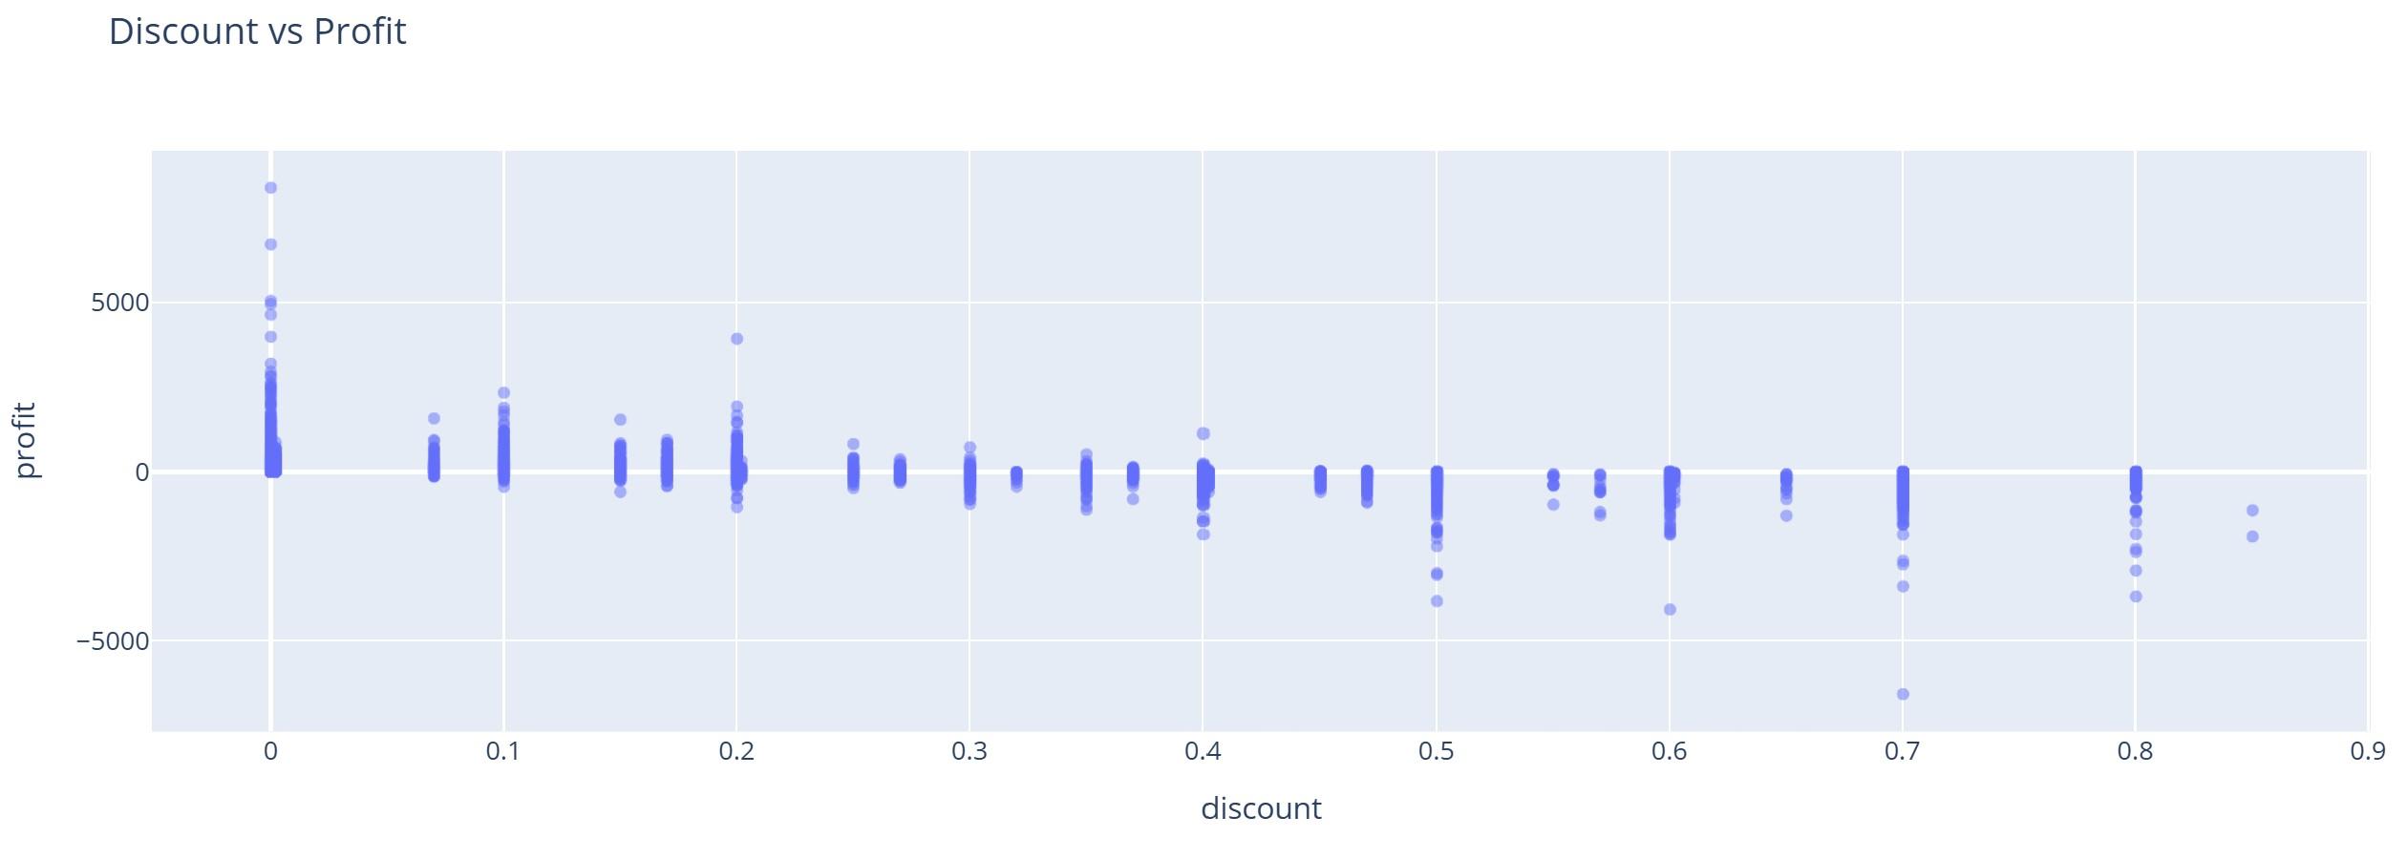
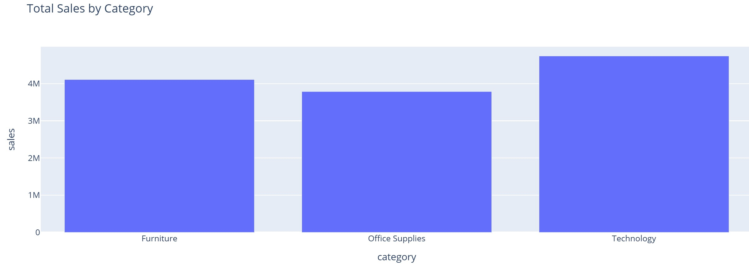
9-How does Discount affect Profit?
Scatter plot to see sensitivity of Profit to Discount; negative slope suggests margin erosion.
10-Which Category generates the highest TOTAL Sales?
Aggregated bar of total Sales per Category to surface revenue drivers.

Slide 34
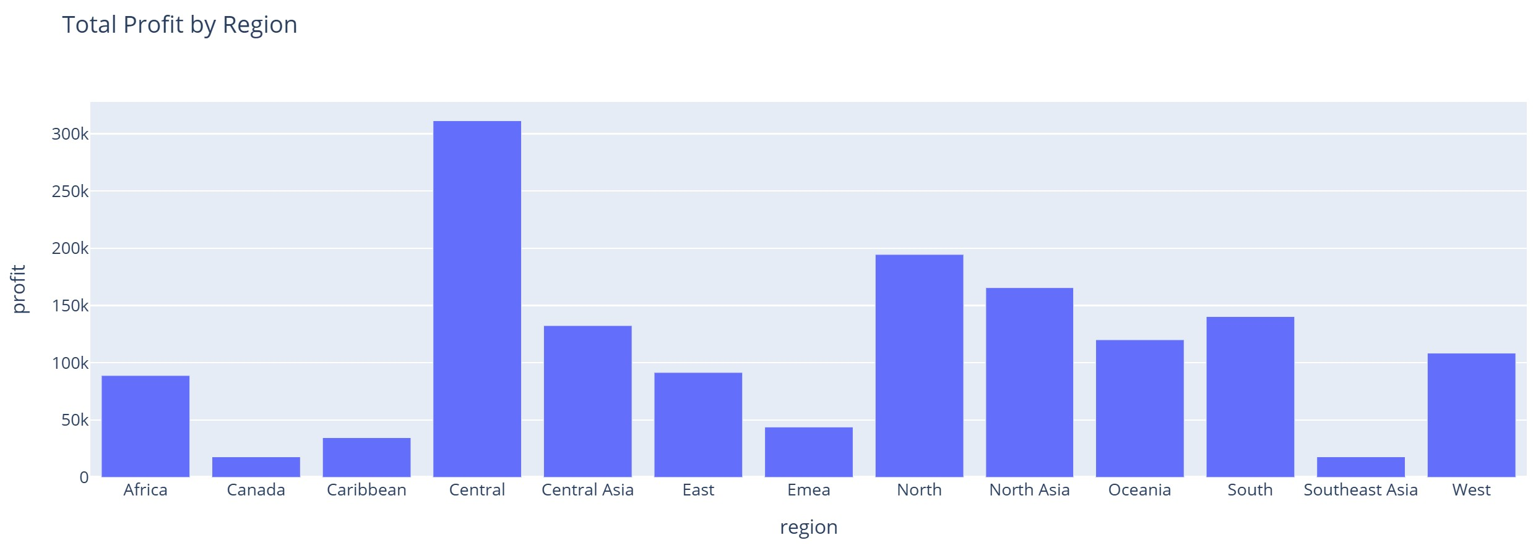
11-Which Region is the most profitable (TOTAL)?
Aggregated bar of total Profit per Region to spot geography-based performance gaps.

Slide 35
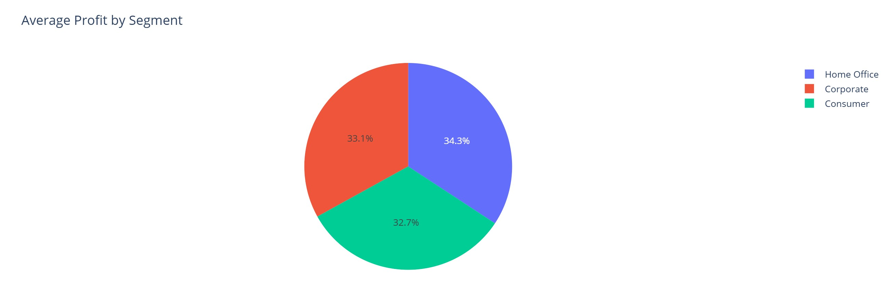
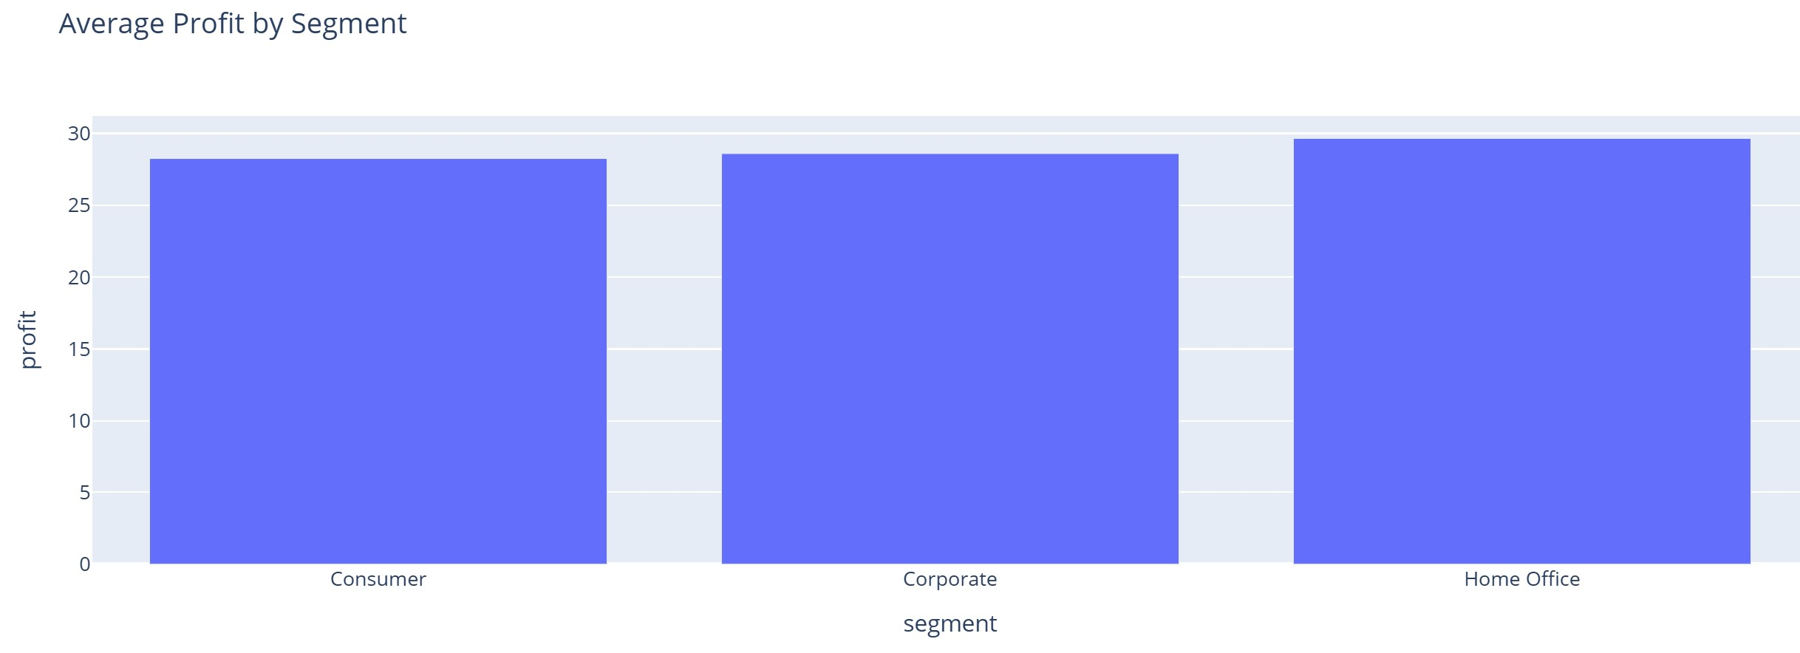
12-Do different Segments have different AVERAGE Profit?
Groups the dataset by segment.
Calculates the average profit for each segment.
Stores the result in a new DataFrame seg_profit.
Creates a pie chart showing each segment’s share of average profit.
Mean bar per Segment shows relative profitability per customer type.

Slide 36
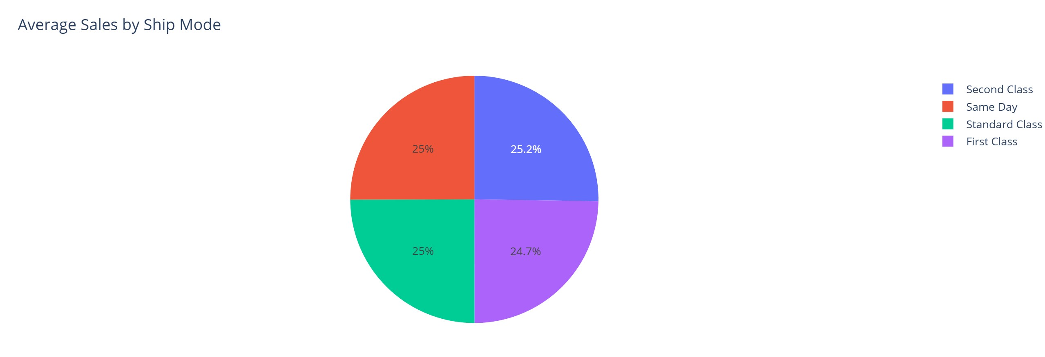
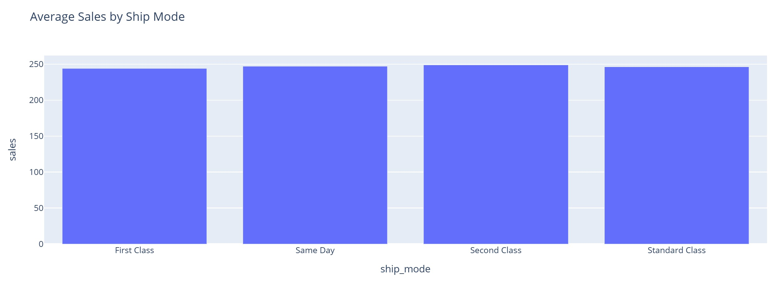
13- How does Ship Mode influence AVERAGE Sales?
Groups the dataset by shipping mode.
Calculates the average sales for each mode.
Stores the result in ship_sales.
Creates a pie chart to show the proportion of average sales by ship mode.
Mean bar per Ship Mode to test if faster shipping correlates with higher basket values.

Slide 37
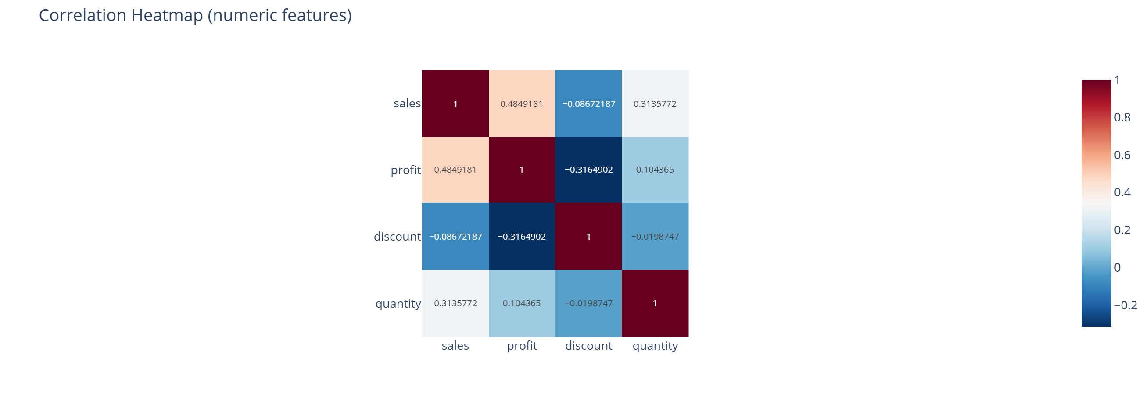
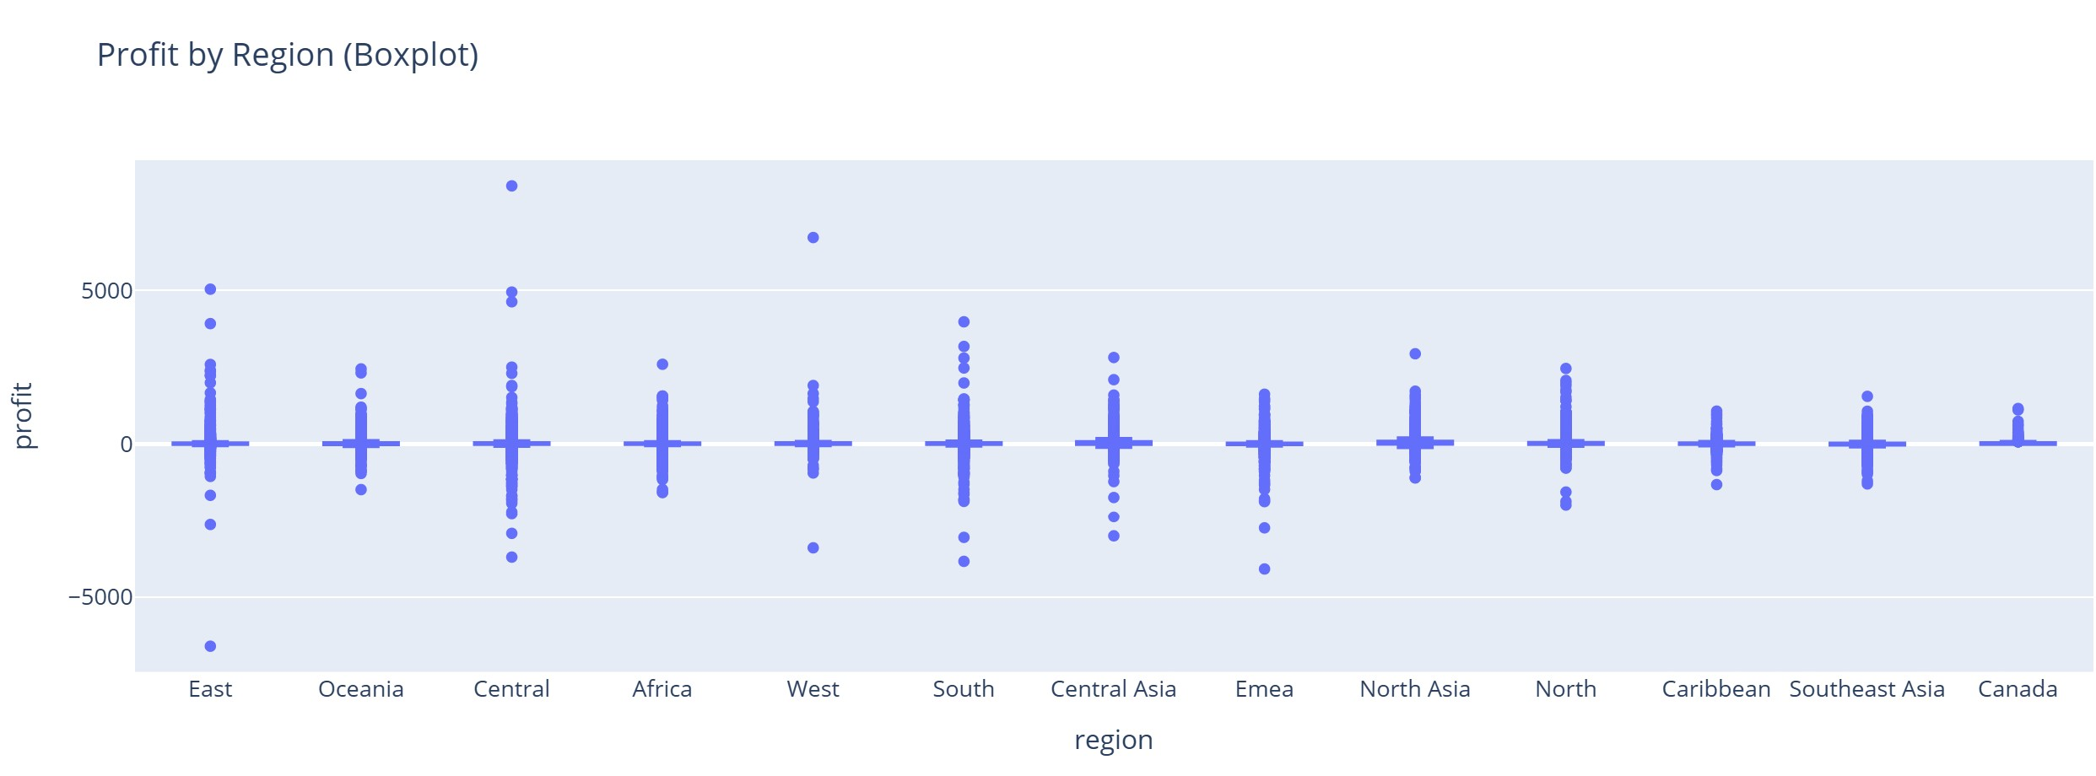
14-Do numeric features correlate?
Correlation heatmap across Sales, Profit, Discount, Quantity to pinpoint strong positive/negative links.
15-How does Profit distribution vary by Region?
Box plot by Region compares spread and medians; highlights regions with volatile profitability.

Slide 38
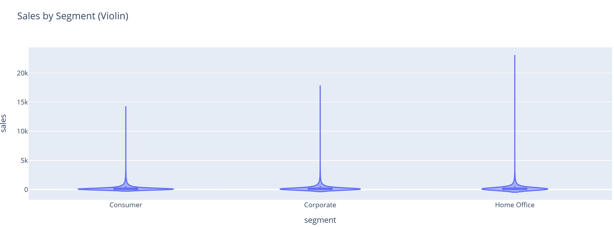
How does Sales distribution vary by Segment?
Violin by Segment shows density differences and outliers across customer groups.

Slide 40
7-Machine Learning Pipeline
1-Define Targets (Regression + Classification).
2-Build Feature Matrix X.
3-Preprocessing.
4-Feature Selection (Embedded / L1) + Core Pipeline.
5-MODEL PERFORMANCE REPORT (Cross-Validated R² Summary).
6-Hyperparameter Tuning (RF / XGB / LightGBM) .
7-Pick and Tune an Algorithm.
8-Auto Build R2_Report + Best Regression Model Selection.
9-Final Regression Evaluation & Save Artifacts.
10-Classification (Precision/Recall ≥ 0.3).

Slide 41
Objective:
Build a robust ML pipeline ensuring data integrity and high predictive performance.
Covers:
Preprocessing, Feature Selection, Model Training, Evaluation, and Classification.

Slide 42
Step 1: Define Targets:
Goal: Define the target variable for both Regression and Classification.
Regression (y_reg): Predict continuous profit values.
Classification (y_clf): Predict profitability (1=Profitable, 0=Loss).
Code:
y_reg = df['Profit'].astype(float)
y_clf = (df['Profit'] > 0).astype(int)
Step 2: Build Feature Matrix:
Goal: Construct X matrix by excluding target and ID columns.
Convert datetime columns to numeric features (Year, Month, DayOfWeek).
Separate numeric and categorical columns.
Ensures consistent input for preprocessing and model training.

Slide 43
Step 3: Preprocessing
Goal: Clean, impute, scale, and encode data before modeling.
Numeric: Impute missing (median) + MaxAbsScaler.
Categorical: Impute (most_frequent) + OneHotEncoder.
Modified build_preprocess() now accepts selector to avoid dependency errors.
Output: Unified ColumnTransformer for both numeric and categorical features.

Slide 44


Step 4: Feature Selection
Goal: Automatically select most important features using Lasso (L1 regularization).
Mathematical form:
min_w (1/2n * ||y - Xw||^2 + α||w||₁)
Pipeline order:
('prep', preprocess) → ('sel', selector) → ('model', estimator)

Slide 45
Step 5: Model Performance Report
Goal: Compare algorithms under same pipeline structure using Cross-validation.
• Models: Linear, KNN, DecisionTree, RandomForest, XGB, CatBoost, LightGBM.
• Metrics: Train R² and Test R².
• Output: R2_Report table summarizing performance.
Ensures fair evaluation and reproducibility.

Slide 46
Step 6: Hyperparameter Tuning Goal: Optimize model performance by tuning parameters using RandomizedSearchCV.
Example:
rf_params = {'Model__n_estimators': [150, 300, 600], 'Model__max_depth': [None, 10, 20, 30]}
Faster by sub-sampling training data.
Output: tuning_summary.json containing best parameters per model.

Slide 47
Step 7 & 8: Model Selection
Goal: Automatically select the best-performing model.
Rank models by Test R².
Save top model into best_regression_model_summary.json.
Ensure reproducibility for deployment or reporting.

Slide 48

Step 9: Final Evaluation
Goal: Assess best model on test data using multiple metrics.
Metrics:
R² – Coefficient of determination
MAE – Mean Absolute Error
RMSE – Root Mean Square Error
Artifacts saved:
final_metrics.json
final_predictions.csv

Slide 49

Step 10: Classification
Goal: Classify profitable vs non-profitable cases.
Models: LogisticRegression, RandomForestClassifier, GradientBoostingClassifier.
Metrics: Precision, Recall, F1 Score.
Academic Criterion: Precision ≥ 0.3 and Recall ≥ 0.3.

Slide 50

Validation & Conclusion
-Validation Summary:
-No data leakage.
-SelectFromModel integrated inside every pipeline.
-Cross-validation and hyperparameter tuning performed.
-End-to-End flow validated successfully.
Result: Pipeline ready for academic and production environments.

